Slide 1
Management Science 461
Lecture 4b – P-median problems
September 30, 2008
Notes:
Lecture 4b

Slide 2
Problem with coverage
Coverage models are best for “worst case problems”
  We want to ensure good response for even the most remote demand node in the network
Density does not drive the model, the lack of density does
Central assumption: if it’s close, it’s covered

Slide 3
Problem with coverage
Coverage model treats each demand node the same (max coverage the exception)
A more appropriate measure is needed to find good average solutions
This is what median problems are good for

Slide 4
Example Network
100
250
14
A
B
13
150
10
E
23
17
C
16
12
Demand
200
D
125

Slide 5
Problem Description
Need to locate facilities and allocate customers to the facility so as to minimize total distance traveled
Decision variables
  Locate at j or not: binary value X_{j}
  Allocate customer i to facility j: binary Y_{ij}

Slide 6
Problem Description
Can’t allocate a customer to facility j if no facility located at j – linking constraints
Need to allocate each customer to a single facility
Need to locate exactly P facilities

Slide 7
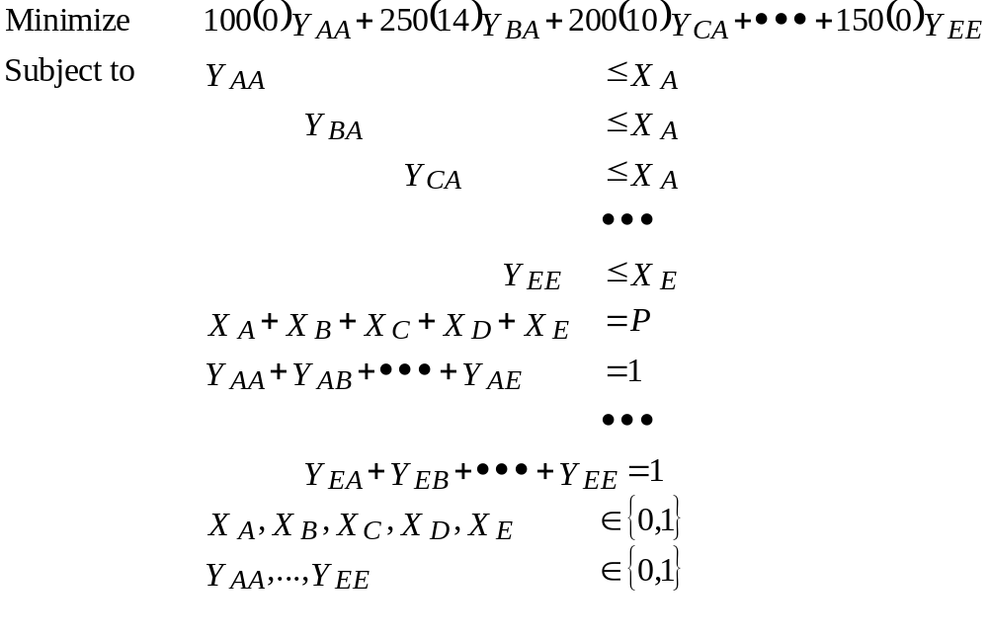
Formulation
Cannot assign demands to an unopened facility
No. to locate
Each demand assigned once
Integrality

Slide 8
Median Solution for P=1
100
250
14
Locate at B for a total demand weighted distance of 10,075
A
B
13
150
10
E
23
17
C
16
12
Demand
200
D
125

Slide 9
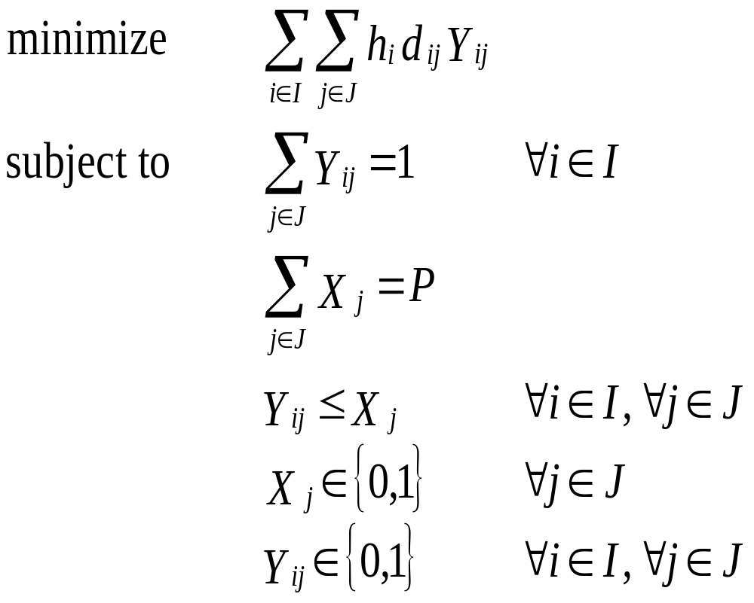
General Formulation

Slide 10
Extensions
Facility costs
  Need to convert total travel to a cost to incorporate both in the same model
Relax “one customer, one facility”
Add a capacity constraint
on facilities
All these things make the problem harder than it already is

Slide 11
Solving 1-Median
Locating a single facility is straightforward:
  Gravity model if location unrestricted and/or no network defined
  Enumeration of all candidate sites
Demo in Excel

Slide 12
Hakimi Proof
A
B
C
D
E
F
H
G
J
Each node has a weight (demand) of wA, wB, wC, etc.

Slide 13
Hakimi Proof
A
B
C
D
E
F
H
G
J
These nodes access the facility through E
These nodes access the facility through F

Slide 14
Hakimi Proof
We collapse the network, and assign all demand that would flow through E to node E, and the same for node F.
wA + wD + wE + wG + wH
(Say, 30 units)
F
wB + wC + wF + wJ
(Say, 40 units)
E
a units
b units
Say a=3, b=7
At this point, we can estimate the current cost of moving demand from nodes E and F to the facility location as
(3 * 30) + (7 * 40) = 370

Slide 15
Hakimi Proof
So having the facility at a=3, b=7 means total travel is 370 km. But what happens when we locate on node E (a=0, b=10)? What about a=10,b=0?
wA + wD + wE + wG + wH
(Say, 30 units)
F
wB + wC + wF + wJ
(Say, 40 units)
E
a units
b units
Say a=3, b=7
Locate on E: (0 * 30) + (10 * 40) = 400 ← HIGHER
Locate on F: (10 *30) + (0 * 40) = 300 ← LOWER
Better solution if we move to the node with higher weight (in this example, move to Node F)

Slide 16
Hakimi Proof
What happens if both E and F have the same demand of 35?
wA + wD + wE + wG + wH
(Say, 35 units)
F
wB + wC + wF + wJ
(Say, 40 units)
E
a units
b units
Say a=3, b=7
a=3, b=7: 3*35 + 7*35 = 350
Locate at either node: 10*35 = 350 ← SAME
Property: When demand at the two nodes is different, can always get a better solution moving to the node with higher weight. If equal demand, all points along the arc (including both nodes) are optimal. Thus, there is always an optimal solution on the node.

Slide 17
Complexity of P-median
Original problem has n choose p solutions: n! / [(n-p)!p!]
For n=10 and p=3, 120 solutions
For n=100 and p=15, 2.5E17 solutions
  At 1,000,000,000 solutions per second, how long would total enumeration take?
“non-polynomial” problem; heuristic solutions needed

Slide 18
Solving the P-median Problem
Greedy adding or Myopic algorithm
Greedy algorithm with Substitution
(Teitz and Bart, 1968, Operations Research)
Neighborhood search
(Maranzana, 1965, Operations Research Quarterly)
Variable neighborhood search
(Hansen and Mladenovic, 1997, Location Science)
Lagrangian relaxation in B&B

Slide 19
The Teitz and Bart Heuristic
Select a random solution
Allocate the demand points to the selected facilities using shortest distances
Compute the total cost of the current solution
For each point A in the current solution
  For each point B, not in the current solution
    Consider replacing A with B
    Compute the total cost of the new solution (after replacement)
    If the new cost is less than the old cost, replace A with B, otherwise keep A in the solution

Slide 20
Teitz-Bart worst case analysis
For n=100, p=15
At each iteration: 15 points in the solution and 85 points outside the solution
Worst case: Check 15*85=1,275 sol’ns per iteration
Usually solved in < 1000 iterations or faster

